Slide 1

Deep Q-Learning for Atari River Raid
Yash Mehta, Yuetian Li,
Yingfei Hong, Nange Li

Slide 2
Introduction
Implemented Deep Q-Learning Networks (DQN) to play Atari 2000 River Raid
Two strategies
fixed Q-targets: handle the oscillation in training due to shifting Q target values
Replay memory: break the correlation between consecutive samples of experience in the environment for efficient learning
Innovations
Custom modifications in reward functions
Goal: train the agent to perform ‘much’ better than random

Slide 3
Methodology
Custom modifications in reward functions
Problems in previous reward function
0 reward for losing one life (Crash)
Modifications:
Reward of -1000 for losing one life
Rescaling the reward to reduce variance
Hit a tanker: 30 -> 0.1
Hit a helicopter: 60 ->0.15
Fuel the depot: 80 ->0.2
Hit a jet: 100 ->0.3
Bridge Strike: 500 ->0.5
Losing one life: -1000 -> -1

Slide 4
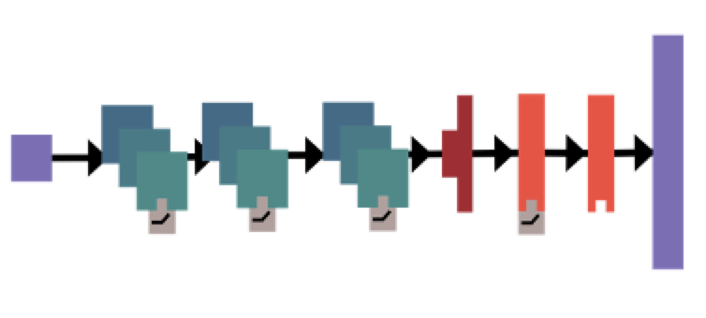
Methodology
Vanilla DQN
 | Channels | Filter size | Strides | Activation | #parameters
Convolutional layer 1 | 32 | 12 | 4 | ReLU | 18464
Convolutional layer 2 | 64 | 6 | 2 | ReLU | 73792
Convolutional layer 3 | 64 | 4 | 1 | ReLU | 65600
 | Hidden size
Dense layer 1 | 640 |  |  | ReLU | 656000
Dense layer 2 (output) | 18 (Number of actions) |  |  | None | 11538

Slide 5
Methodology
Fixed target
Where s is the current state, s’ is the next state after taking the action a, r is the reward for taking the action a, 𝛾 represents the discounted factor, Q is the Q network, is the target network and every T steps: w’ = w.
Memory Mechanism
Memory: a fixed number of experiences
Experience: (s, a, r, s’)
Use past experience to update Q
Randomly sample a small batch from memory
For each experience, the error will be:

Slide 6
Results
Random Model
Trained Agent
 | Random Model | Trained Agent
Average rewards | -0.660 | 0.932
last 50 episodes’ reward | -0.615 | 1.094
last 50 episode’ #steps | 26.6 | 105.6
(Accelerated Recordings)

Slide 7
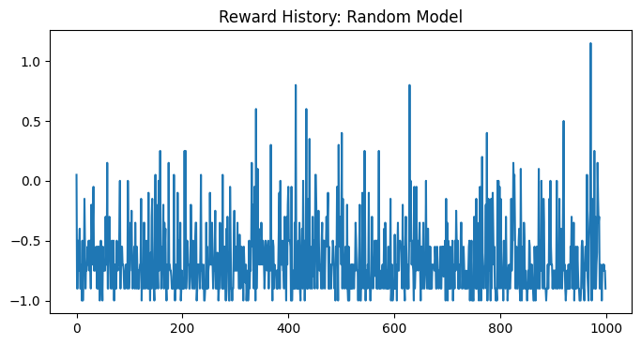
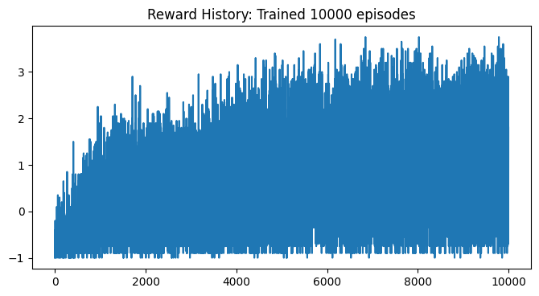
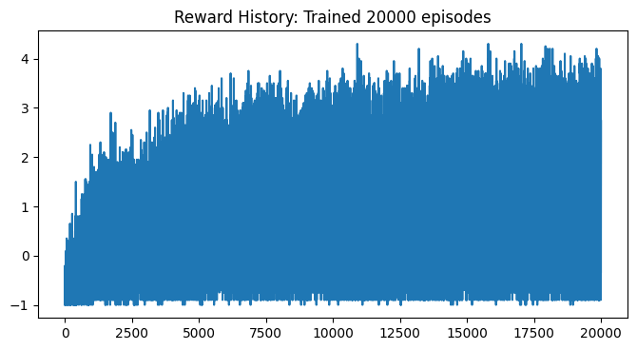
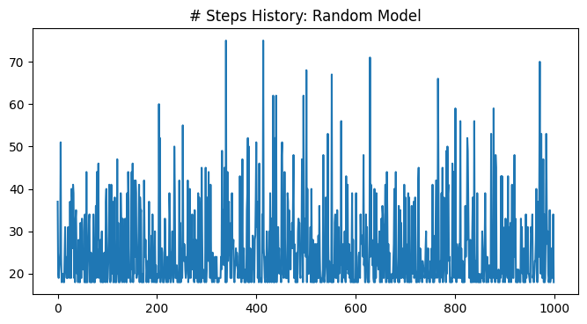
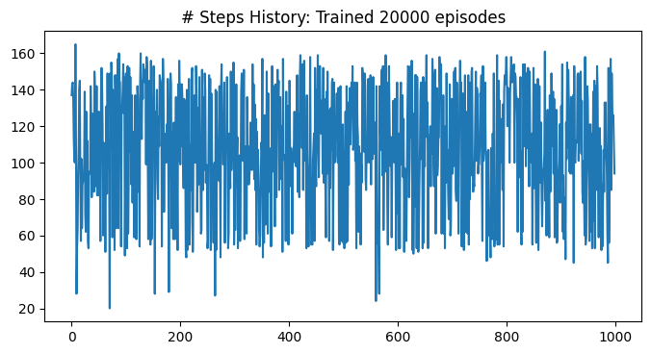
Results
Random Model
Trained Agent

Slide 8
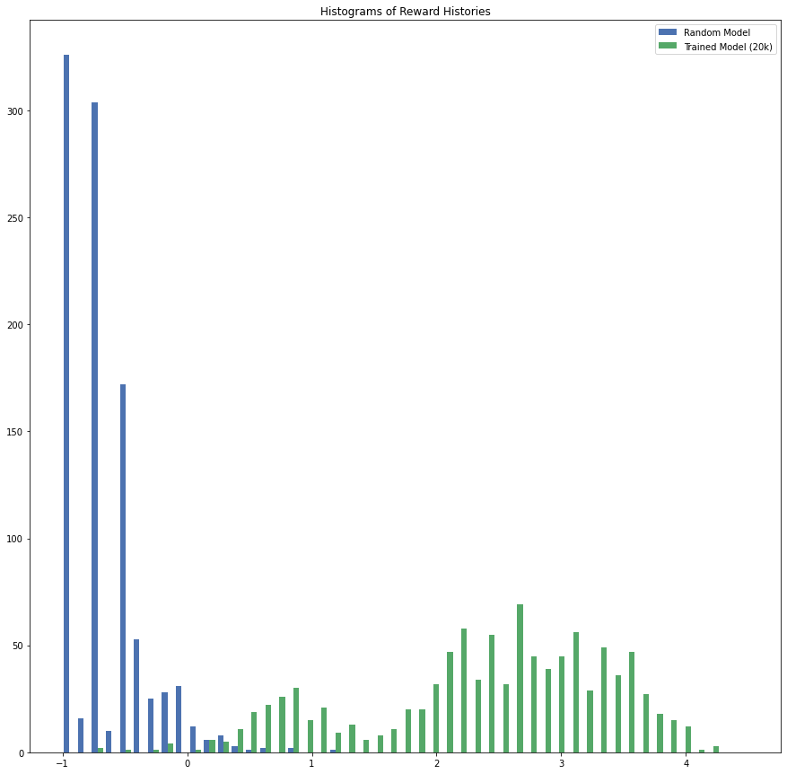
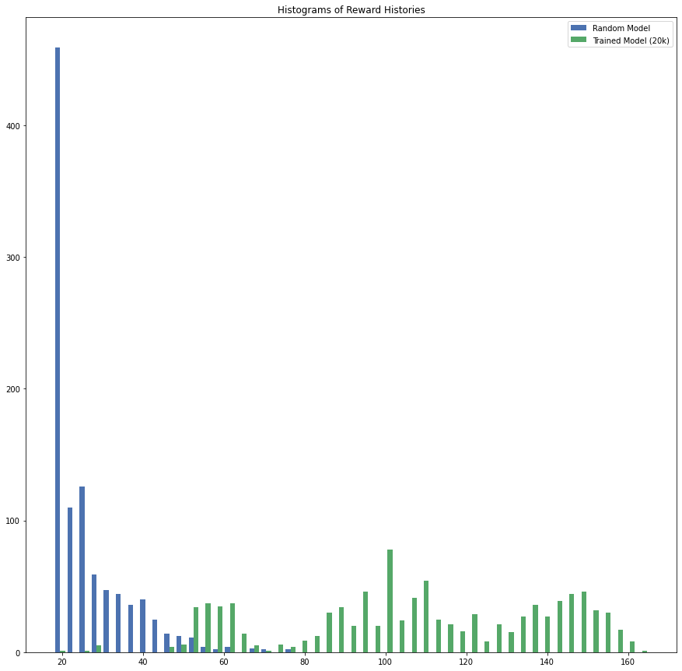
Results
Rewards History Comparison between Trained Model and Random Model
Step History Comparison between Trained Model and Random Model

Slide 9
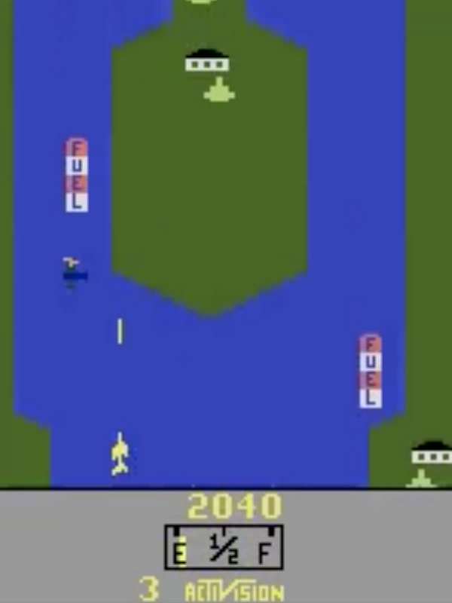
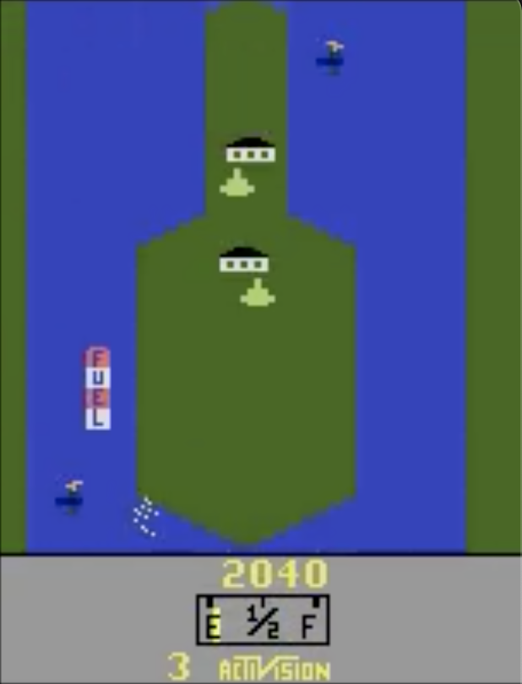
Discussion and Outlooks
Fly over (Refuel) v.s. Shoot the fuel depot (80 points)
Crashed when running out
On purpose?
Model didn’t learn that far
Modification of loss function
Scores & Remaining fuel

Slide 10
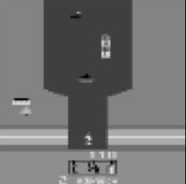
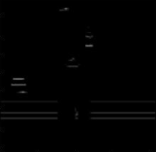
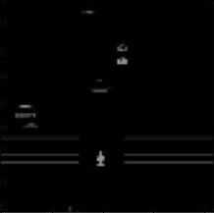
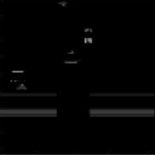
Discussion and Outlooks
Double DQN Model
Implemented but not tuned
K-skipping strategy with different k values
Larger k - faster and more info for each prediction
Action repeated by k times - less precision
Difference of consecutive game frames

